Slide 1
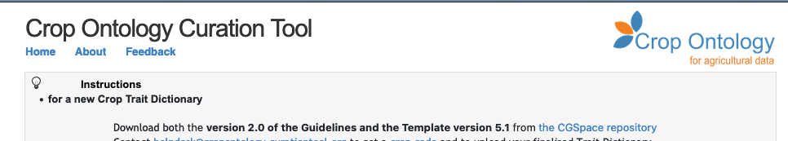

Crop ontology

Slide 2
Semantic in a nutshell

Slide 3
Semantic
Define concepts: plant, micro_plot, phenotype, experiment, event
Define Relations: micro_plot contains plant
Common Vocabularies and ontologies
Agrovoc, Plant Ontology, Crop Ontology, Environment Ontology, …
Study
Genotype
Observation Unit
Factor
hasGenotype
Treatment
Treatments
Plant
Measure
contains
is-applied
contains
Value
Time
micro_plot
plot
Ontology

Slide 4


Semantic Inference
Uncouple
Data capture
Data analysis
Data reuse
Inference allows to format the data for a target use
Plant
hasGenotype
Genotype
hasGenotype
contains
Micro-Plot
factors
treatment
is-applied
contains
is-applied
Plot

Slide 5
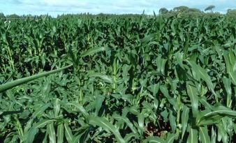
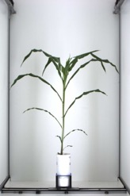
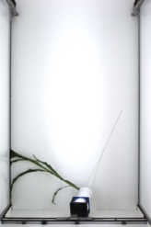
Annotation of events: plot and plant accidents
L. Cabrera-Bosquet & P. Neveu
anno480
oa:hasTarget
Plot 97
Plot 98
plot97
dcterms:creator
dcterms:created
oa:bodyValue
"2017-06-29”
‘Plots lodged after the storm’
Romain
anno86
oa:hasTarget
plant795
dcterms:creator
dcterms:created
oa:bodyValue
"2017-05-15”
‘Fallen plant during imaging’
Llorenç
Events or follow the Web Annotation Data Model that allows assigning motivation and purpose attributes to annotations (e.g. oa:describing, oa:identifying, oa:linking, oa: replying, etc.). Dublin Core properties such as dcterms:created or dcterms:creator are also used.

Slide 6
CROP ONTOLOGY and Planteome
www.cropontology.org
Elizabeth Arnaud, Marie Angélique Laporte et al.

Slide 7


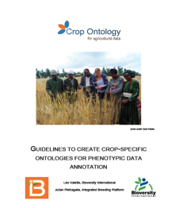
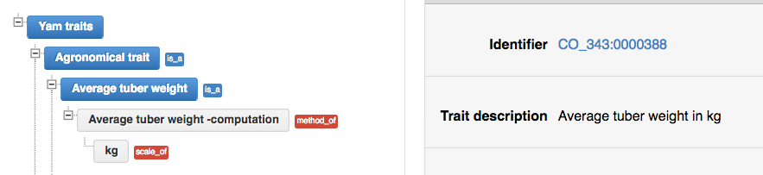
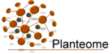
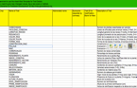

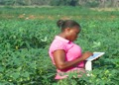
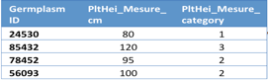
Crop Ontology for Trait Data
www.cropontology.org
27 Plants (latest Sugar Kelp - algae)
Good Practice for Trait Data Annotation
Submission of new traits & variables
Community selects traits and standard variables
Create Fieldbook with Ontology
Data collect
with standard variables
Formatted files in repositories or databases
Use of the formatted
data files

Slide 8



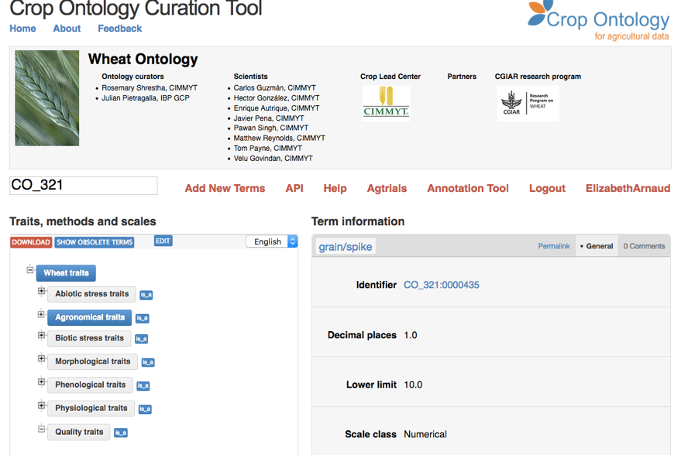
www.cropontology.org
Banana
Barley
Beet
Brachiaria
Brassica
Cassava
Castor bean
Chickpea
Common bean
Cowpea
Groundnut
Lentil
Maize
Mungbean
Oat (Global Triticeae)
Pearl millet
Pigeon Pea
Potato
Soybean (IITA & USDA)
Sweet Potato
Rice
Sorghum
Vitis (INRA)
Wheat (CIMMYT + INRAE)
Woody species
Yam

Slide 9




















Where is Crop Ontology applied?
WheatIS Interoperability
Cookbook
CGIAR
repositories
Notes:
BMS: At the source! Edition of fieldbooks
Agtrials= env 30 000 CO annotated trials

Slide 10


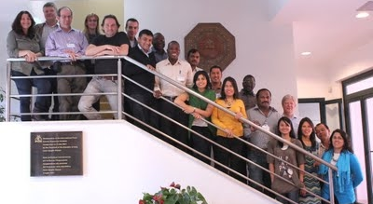
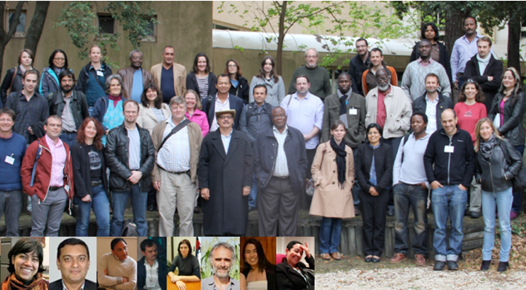
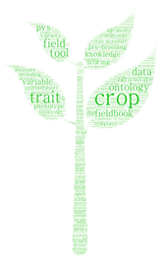
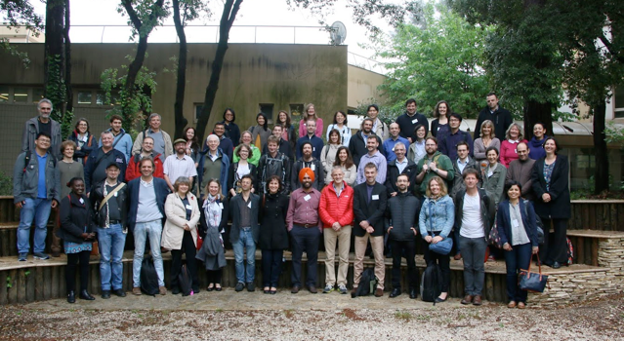
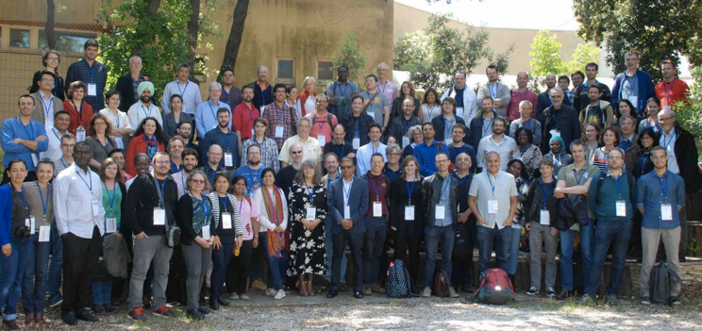
A Growing Community Of Practice
2012
2014
Upload your CoP Photo !
2016
2018

Slide 11

Reference Plant Ontologies
Mapping to species agnostic ontologies
to expand results of a crop trait search

Slide 12
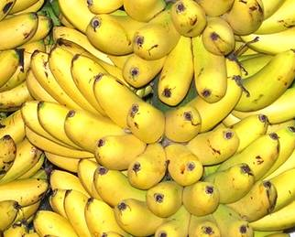
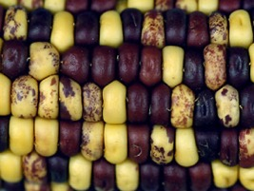
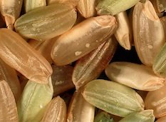
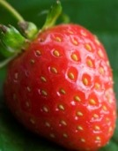
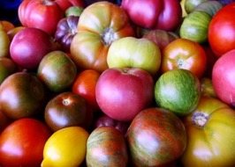
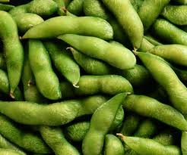
Specialized vocabularies
Finger Color
Kernel Color
Grain Color
Achene Color
Berry Color
Pod Color

Slide 13
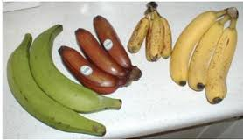

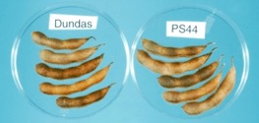
Common Reference Ontology
Finger color
Banana Trait Ontology
Fruit Color
Berry color
Pod color
Reference
Trait Ontology
Tomato Trait
Ontology
Soybean Trait Ontology

Slide 14


Common Reference Ontology
Finger color
Banana Traits
Fruit Color
Berry color
Pod color
Reference
Trait Ontology
Soybean Traits
Tomato Traits

Slide 15
CROP ONTOLOGY in miappe

Slide 16

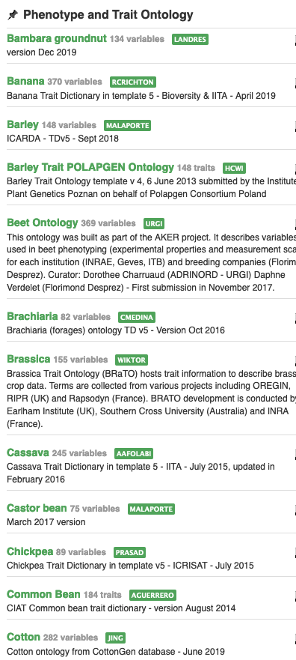
Context
Need
Importance of controlled vocabularies and ontologies for data annotation and FAIRness
Must respect crop specificities
Answer
Development of a standard to build ontologies to annotate phenotypes: “Crop Ontology”
Crop-specific vocabulary established by its community
31 ontologies crop-specific available (including woody plants): www.cropontology.org
Study | Genotype | CIR | HT | SUR
Domaine de Valcros | 6579 | 600 | 17 | 1
Domaine de Valcros | 6580 | 482 | 14 | 1
Study | Genotype | H | CIR
La Nerthe | 6579 | 23 | 650
La Nerthe | 6580 | 28 | 514

Slide 17
Standard model
Variable = trait + method + scale
The phenotypic observation
Trial | Genotype | CIR | HT | SUR
Domaine de Valcros | 6579 | 600 | 17 | 1
Domaine de Valcros | 6580 | 482 | 14 | 1
Variable | Variable ID
 | Variable name
 | Variable synonyms
 | Context of use
 | Growth stage
 | Variable status
 | Variable Xref
 | Institution
 | Scientist
 | Date
 | Language
 | Crop

Slide 18
Standard model
Variable = trait + method + scale
What is the studied character?
Trial | Genotype | CIR | HT | SUR
Domaine de Valcros | 6579 | 600 | 17 | 1
Domaine de Valcros | 6580 | 482 | 14 | 1
Trait | Trait ID
 | Trait
 | Trait class
 | Trait description
 | Trait synonyms
 | Main trait abbreviation
 | Alternative trait abbreviations
 | Entity
 | Attribute
 | Trait status
 | Trait Xref
Circumference of the tree
Total height of the tree
Survival state of the tree

Slide 19
Standard model
Variable = trait + method + scale
How is it observed?
Trial | Genotype | CIR | HT | SUR
Domaine de Valcros | 6579 | 600 | 17 | 1
Domaine de Valcros | 6580 | 482 | 14 | 1
Method | Method ID
 | Method
 | Method class
 | Method description
 | Formula
 | Method reference
Measured at breast height with a graduated ribbon
Measured from soil to crown with a pole or a clinometer
Visual assessment with a reference scoring scale

Slide 20
Standard model
Variable = trait + method + scale
How is it expressed (unit or scale)?
Trial | Genotype | CIR | HT | SUR
Domaine de Valcros | 6579 | 600 | 17 | 1
Domaine de Valcros | 6580 | 482 | 14 | 1
Scale | Scale ID
 | Scale name
 | Scale class
 | Decimal places
 | Lower limit
 | Upper limit
 | Scale Xref
 | Category 1
 | Category 2
 | …
 | Category n
cm
mm
0 = Alive
1 = Dead
2 = Doubtful

Slide 21
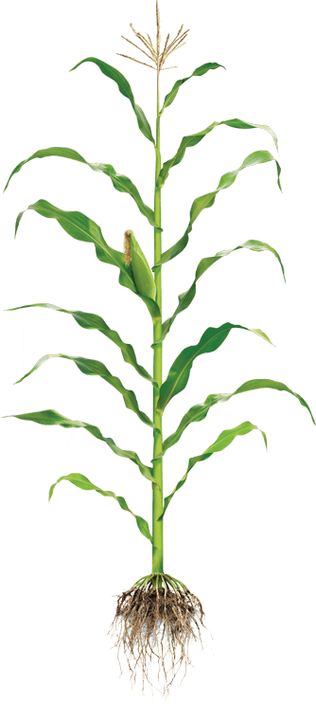
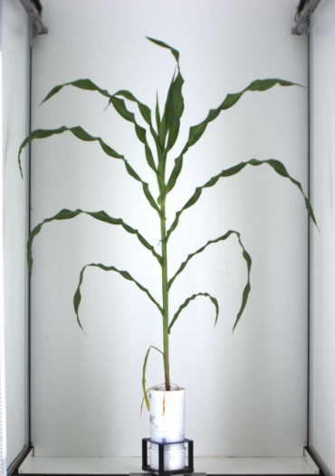

Controlled Vocabulary Challenge
Phenotyping/environment variable = Trait + Method + Unit/Scale
+
+
Trait
Method
Unit
M1: Total height
M2: First tassel branch
M3: Last expanded leaf
M4: Youngest growing leaf
U1: cm
U2: mm
We need Species specific CV/Ontologies
BUT
Near infinite number of combination
T1: Plant Height
M5: Highest pixel corresponding to plant
U3: pixel
L Cabrera

Slide 22
Controlled Vocabulary Challenge
Variable annotation
Using MIAPPE for minimal variable description
Optional reference to existing crop ontology
Ad hoc Trait or Method or Scale in MIAPPE dataset
Focus on Trait for interoperability

Slide 23
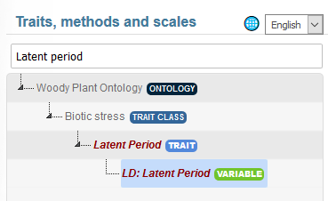
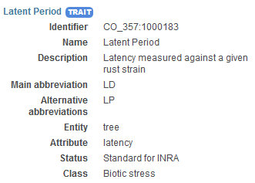
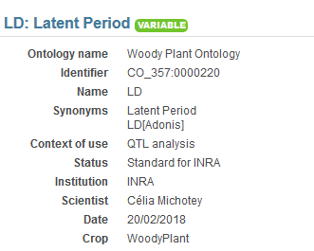
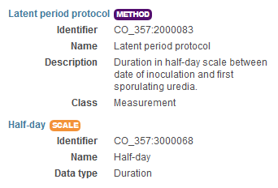
Controlled Vocabulary Challenge
Variable annotation Example 1
Trait | Trait description
L98AR1 | Latent Period for strain 98AR1
L93CV1 | Latent Period for strain 93CV1
Canker_LL | Canker lesion length

Slide 24
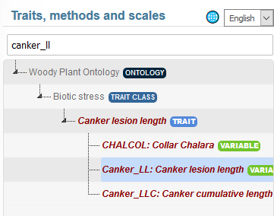
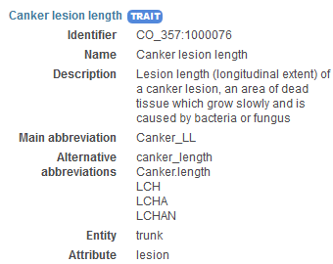
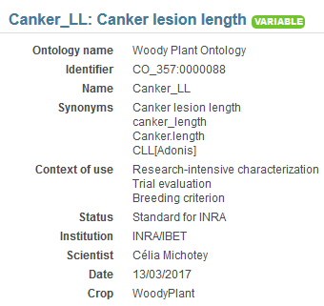
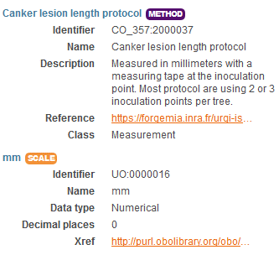
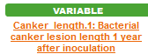
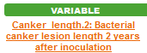
Controlled Vocabulary Challenge
Variable annotation Example 2
Trait | Trait description
L98AR1 | Latent Period for strain 98AR1
L93CV1 | Latent Period for strain 93CV1
Canker_LL | Canker lesion length
24

Slide 25
Controlled Vocabulary Challenge
Trait decomposition to Entity/Attribute
Trait = Leaf Area ➔ Entity = Leaf, Attribute = Area
Enables ad hoc controlled vocabulary + Trait Interoperability
Formalized by Mungal et al 2009
Existing in crop ontology
EMPHASIS proposition : Use for easy Variable creation and interoperability

Slide 26
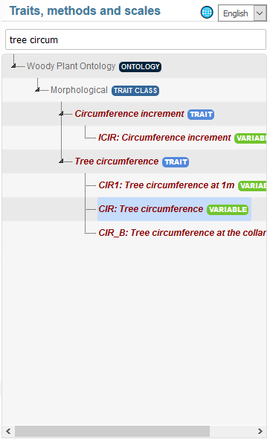
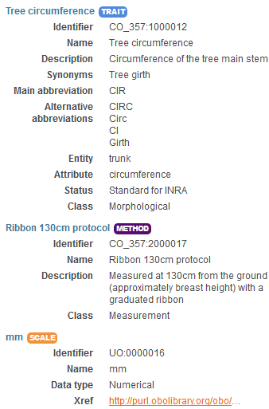
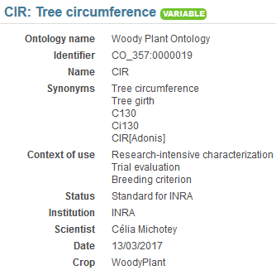
Tree Variable example1 https://urgi.versailles.inra.fr/ontologyportal#termIdentifier=CO_357:0000019
1 Trait
3 Variables
3 methods

Slide 27
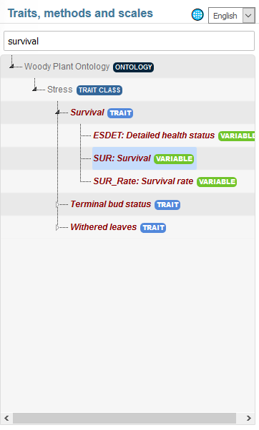
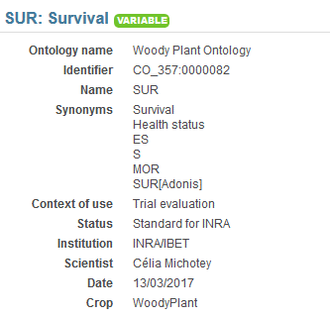
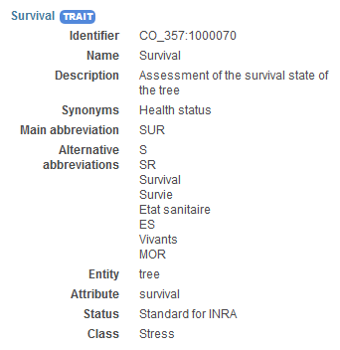
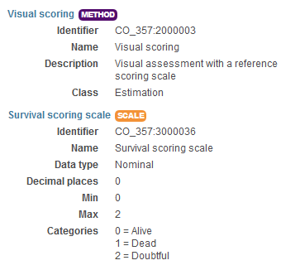
Tree Variable example2 https://urgi.versailles.inra.fr/ontologyportal#termIdentifier=CO_357:0000082

Slide 28
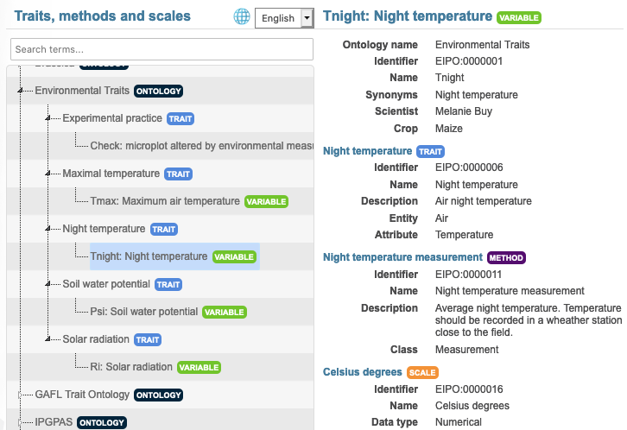
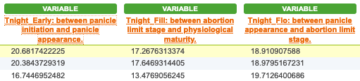
Environnemental Variable example
Variable annotation

Slide 29
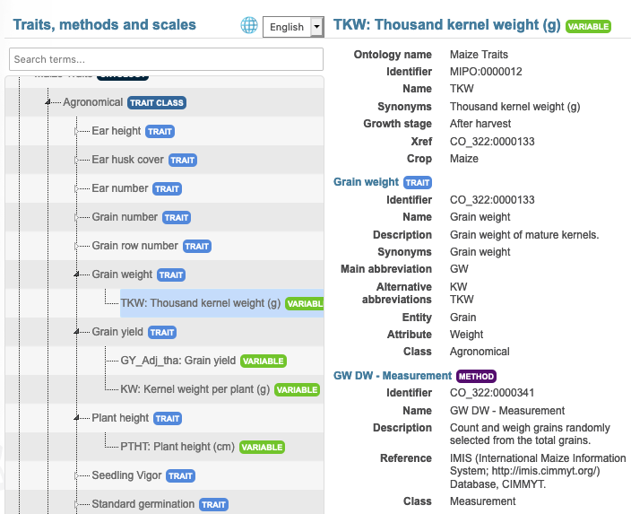

Crop Variable example
Ad Hoc Variable
Trait: reference Crop Ontology Maize

Slide 30









Crop Ontology repositories and workflow
Repository, some crop ontologies
Version History
Repository, some other crop ontologies
Search over several ontologies
Trait Dictionary Template v5
Plant scientist friendly browser
https://urgi.versailles.inra.fr/ontologyportal

Slide 31
Wheat CROP Ontology
https://doi.org/10.15454/3EDMCP
Cyril Pommier, Rosemary Shreshta et al.

Slide 32
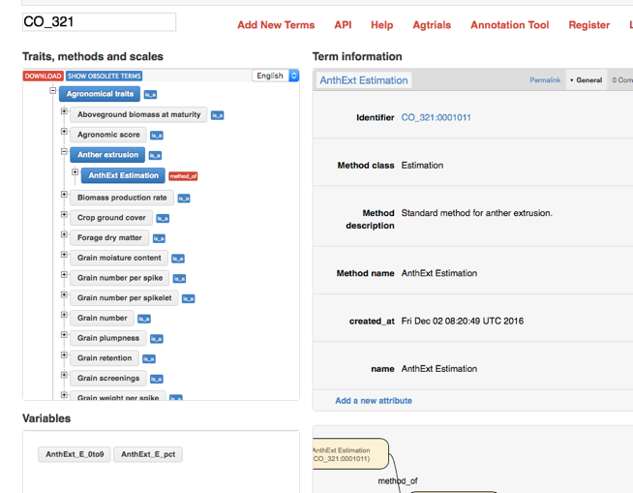
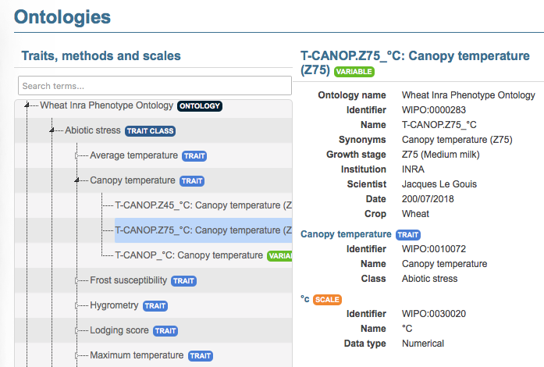
Wheat Trait Ontologies
CIMMYT Crop Ontology
CGIAR, IBP, INRAE …
497 variables
R. Shreshta, T. Letellier, J. Legouis, C. Pommier
http://www.cropontology.org/ontology/CO_321/Wheat
Wheat INRA Phenotype Ontology
WhealBI H2020, Breedwheat, Phenome-Emphasis.fr
50 variables
T. Letellier, J. Legouis
https://urgi.versailles.inra.fr/ontology#termIdentifier=WIPO:0000001

Slide 33
An ontology for Wheat
Description
Lists reference variables used for experimentations and observations organized following the Crop Ontology standard
International initiative based on various communities (CIMMYT, INRAE, Whealbi H2020, USDA (T3), … )
DOI : https://doi.org/10.15454/3EDMCP
English only
Access
GnpIS ontology portal
CropOntology
Ontology Lookup Service (EBI’s OLS)
AgroPortal
FAIRsharing

Slide 34
First Hands On

Slide 35
Fill TDv5 for the following variables
AGM
The Above-ground matter of the plants have been harvested for a whole plot, dried out then weighted. The result has been expressed in grams by square meters and tons by hectares
Same measure as above but at anthesis rather than harvest.
Same but express the developmental stage using zadock (optional)
Grain Yield
The grain were harvested then weighted at 0% and 15% humidity. The result where expressed in q/ha and grams per square metters
Disease
Septoria was inoculated, the inoculation date being recorded as julian date, day of year and degree days. The Septoria score was evaluated on two leaves, with a 1 (Resistant) to 9 (Susceptible) notation scale. Agent: Mycosphaerella graminicola (Septoria tritici). Symptoms: the lesions are linear and restricted laterally. The following methods were used for measurement: Saari and Prescott, 1975; Eyal et al., 1987; Duveiller et al., 2012.

Slide 36
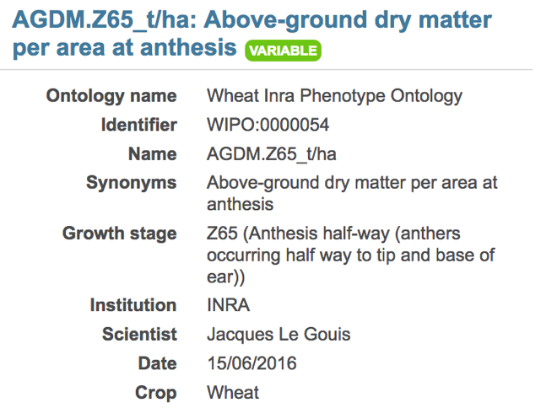
Wheat Variable exemple : Variable
Variable ID | Variable name | Variable synonyms | Context of use | Growth stage | Variable status | Variable Xref | Institution | Scientist | Date | Language | Crop
WIPO:0000054 | AGDM.Z65_t/ha | Above-ground dry matter per area at anthesis |  | Z65 (Anthesis half-way (anthers occurring half way to tip and base of ear)) |  |  | INRA | Jacques Le Gouis | 15/06/2016 | EN | Wheat

Slide 37

Wheat Variable exemple : Variable
Method ID | Method name | Method class | Method description | Formula | Method reference
WIPO:0020007 | Direct measure |  | Mesure directe # ModeOp Arvalis = Sur 0.7 m² |  | PDF URL + PAGE

Slide 38

One Trait with multiple variables

Slide 39

One Trait with multiple variables

Slide 40

One Trait with multiple variables

Slide 41

Yield: many variables

Slide 42

Variable by stage Combination
Usefull for genetic analysis but:
Number of variable combination explosion
Poor data reusability
Recommandation: One variable for the trait and one for the phenology. Then combine depending on your scientific question

Slide 43
Hands On
How many variables from the following description :
In the popyomics study of the populus canker lesion impact, the trees where inoculated with strains 98AR1 and 93CV1. The lesion lenght, ie the impact of the inoculation, was measured one and two years after inoculation.

Slide 44


Variable annotation
Study | QTL | Trait | Trait description
POPYOMICS | Pop2_qtl1 | L98AR1 | Latent Period for strain 98AR1
POPYOMICS | Pop2_qtl2 | L93CV1 | Latent Period for strain 93CV1
POPYOMICS | Pop2_qtl3 | Canker_LL | Canker lesion length

Slide 45
Variable annotation
Trait | Trait description
L98AR1 | Latent Period for strain 98AR1
L93CV1 | Latent Period for strain 93CV1
Canker_LL | Canker lesion length

Slide 46
Variable annotation
Trait | Trait description
L98AR1 | Latent Period for strain 98AR1
L93CV1 | Latent Period for strain 93CV1
Canker_LL | Canker lesion length

Slide 47
Phenology handling, the woOdy plant ontology example

Slide 48
BBCH scale, Woody Plant ontology example
Scale used to identify the phenological development stages of plants
Bud development
Leaf development
Stem development and elongation
Flowering
Fruit development
Senescence
Uses a decimal code system, which is divided into principal and secondary growth stages
Woody BBCH
Development of a BBCH scale for Forest Plants by the project TEMPO (French network of observatories dedicated to phenology for the entire living kingdom) => homogenize variables and facilitate data links
BBCH-scale available in the Woody Plant Ontology

Slide 49




BBCH scale, Woody Plant ontology example

Slide 50
Application to your variables
Pick some relevant variables in your datasets
Describe them as text
Try to find corresponding variables in the crop ontology.
Format your variables using TDv5

Slide 51
How to contribute?
Create your variables
In an empty CropOntology template (Trait Dictionary template v5)
Or complete the last version of the Woody Plant Ontology
Use Crop Ontology github
https://github.com/Planteome/ibp-wheat-traits/issues

Slide 52
Variable viewer https://urgi.versailles.inra.fr/ephesis/ephesis/ontologyportal.do#termIdentifier=CO_357
Embed in your own web page/system
https://brapi.org/brapps

